Slide 1
Applied Natural Language Processing
Dr. Sucharitha Shetty

Slide 2
Table of Contents
Bi-directional RNN

Slide 3
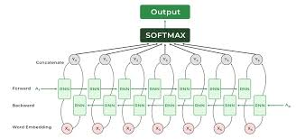

Slide 4
What is NER ?
NER involves identification of proper names in texts, and classification into a set of predefined categories of interest.
Three universally accepted categories:
  Person, location and organisation
Other common tasks: recognition of date/time expressions, measures (percent, money, weight etc), email addresses etc.
Other domain-specific entities: names of Drugs, Genes, medical conditions, names of ships, bibliographic references etc.

Slide 5
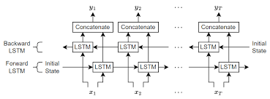
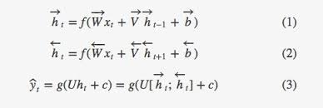

Slide 6
